Slide 1


Aditya Shandilya
4th Dec 2024

Slide 2

Outline
Executive Summary
Introduction
Methodology
Results
Conclusion
Appendix

Slide 3
Executive Summary
Launching payloads of any sort was a one-and-done kind of a scenario - but not after SpaceX came up with cheaper (~2x cheaper) means to do it, incorporating reusable parts (mainly the ‘Phase 1’ of the rocket ship).
As SpaceY, we need to figure out how and where we can have a competitive edge against SpaceX, given that we do have all the cutting edge space tech on our side
With the goal of achieving maximum efficiency in deploying payloads onto the Earth’s orbit and beyond, a machine learning model is built to assess the probability of reusing the Phase1, based on the payload, and launch site metrics among others
The model was trained on past launch data of SpaceX from 2010 to 2020.
The model will be used to classify whether the launch will be a success or not based on features mentioned above
The cumulative understanding extracted from this is the ranges of said metrics which keep the probability of success inside the “risk of failure” zone

Slide 4
Introduction
This project was meant to shed light on commercialization of space launches due to one particular company, SpaceX
The study was performed keeping in mind that as SpaceY, we can compete with the pioneers by offering better prices or probabilities of success when compared to SpaceX, currently the most cost effective rocket company
Thus, the problem we were faced with was two-fold:
First, in finding the right metrics to judge the probability of success of a launch
Second, in being confident of our judgement
SpaceX provides APIs to its database; it contains all the information on each launch dating from their first to their latest.
We will be using this data, along with other data sources to equip our data science approach

Slide 5

Section 1

Slide 6
Methodology
Executive Summary
Data collection methodology:
Used the open source APIs to SpaceX’s database to retrieve information on their past launches, payloads, launch sites and rockets used in each launch
Web-scraped tables describing some launch metrics from Wikipedia
Data wrangling
Each missing feature value was replaced with values that reflected realistic situations
Sufficient data was accumulated and standardized from different sources
Performed exploratory data analysis (EDA) using visualization and SQL
Performed interactive visual analytics using Folium and Plotly Dash
Performed predictive analysis using classification models

Slide 7
Data Collection
SpaceX provides a set of REST APIs that can be used to access their databases which have all necessary information about their rocket ships and their launches
https://api.spacexdata.com/v4/launches/past - API to download all the past launches, successful as well as failed ones from SpaceX repos
https://api.spacexdata.com/v4/cores/ - Core data that shall inform on outcome of the landing, the type of the landing, number of flights with that core, whether gridfins were used, whether the core is reused, whether legs were used, the landing pad used, etc.
https://api.spacexdata.com/v4/payloads/ - to learn the mass of the payload and the orbit that it is going to
https://api.spacexdata.com/v4/launchpads/ - to know the name of the launch site being used, the longitude, and the latitude
https://api.spacexdata.com/v4/rockets/ - to know the name of the booster

Slide 8
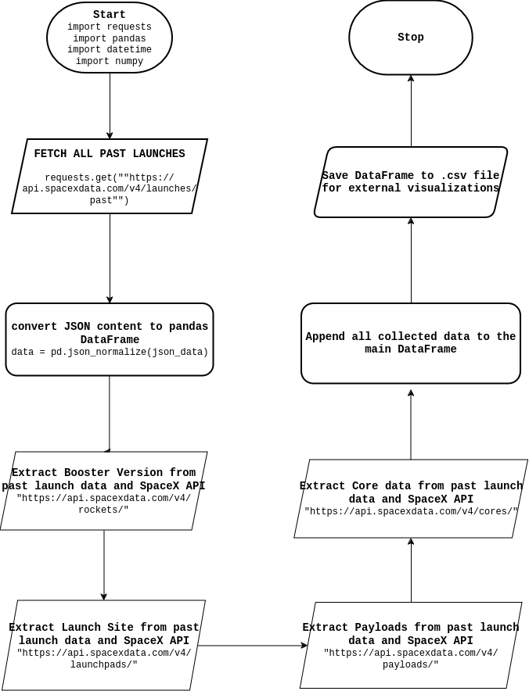
Data Collection – SpaceX API
The requests python package helps with HTTP protocol for using the REST APIs provided by SpaceX
Functions are created for each extraction process, which will fetch the information needed for every row of data available in the dataframe
Add the GitHub URL of the completed SpaceX API calls notebook (must include completed code cell and outcome cell), as an external reference and peer-review purpose

Slide 9
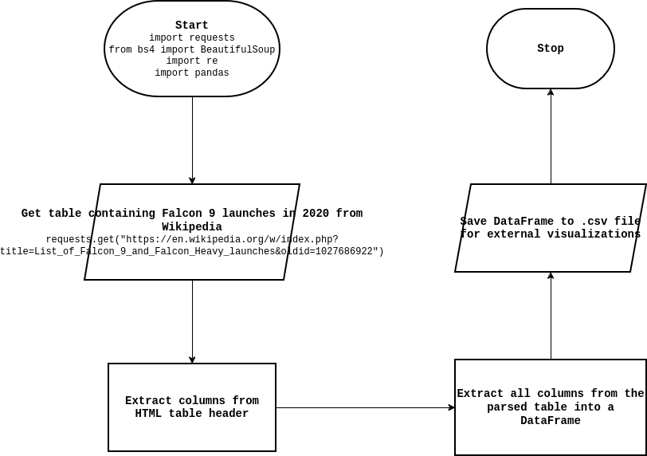
Data Collection - Scraping
BeautifulSoup Python Package is used to parse HTML content from web source files
Wikipedia page on Falcon 9 launches in 2020 holds tables consisting detailed information on each launch
This page is chosen for scraping
Add the GitHub URL of the completed web scraping notebook, as an external reference and peer-review purpose

Slide 10
Data Wrangling
Data pre-processing was performed on the past launches dataset, on all columns which were having missing data:
5 missing values in columns Payload Mass, replaced by mean of the feature
26 missing values for Landing Pad, replaced by 0s, depicting that the landings were a failure
Converted the outcome column to have binary values, 1 - success and 0 - Failure
Calculated the number of launches on each site, where Cape Canaveral Space Launch Complex leads with 55 launches
Most successful and popular orbit to launch payloads to has been GTO(Geosynchronous Transfer Orbit), being the destination for the max of 27 payloads
There are 8 types of occurrences recorded - 5 depicting negative and 3 positive outcomes
Add the GitHub URL of your completed data wrangling related notebooks, as an external reference and peer-review purpose

Slide 11
EDA with SQL
Displayed the names of the unique launch sites in the space mission
Displayed 5 records where launch sites begin with the string 'CCA'
Displayed the total payload mass carried by boosters launched by NASA (CRS)
Displayed average payload mass carried by booster version F9 v1.1
Listed the date when the first succesful landing outcome in ground pad was acheived
Listed the names of the boosters which have success in drone ship and have payload mass greater than 4000 but less than 6000
Listed the total number of successful and failure mission outcomes
Listed the names of the booster_versions which have carried the maximum payload mass. Use a subquery
Listed the records which will display the month names, failure landing_outcomes in drone ship ,booster versions, launch_site for the months in year 2015
Ranked the count of landing outcomes (such as Failure (drone ship) or Success (ground pad)) between the date 2010-06-04 and 2017-03-20, in descending order
Add the GitHub URL of your completed EDA with SQL notebook, as an external reference and peer-review purpose

Slide 12
EDA with Data Visualization
Visualized the relationship between Flight Number and Launch Site to understand the chronology of Site choice, if existing
Visualized the relationship between Payload Mass and Launch Site, shows the correlation between the two factors
Visualized the relationship between success rate of each orbit type as it will help judging the success rate directly
Visualized the relationship between FlightNumber and Orbit type, didn’t find much
Visualized the relationship between Payload Mass and Orbit type
Visualized the launch success yearly trend, and it gets better by the year
Created dummy variables to categorical columns
Casted all numeric columns to float64
Add the GitHub URL of your completed EDA with data visualization notebook, as an external reference and peer-review purpose

Slide 13
Build an Interactive Map with Folium
Used Markers, Clusters, Icons and lines to show Launch Sites, Landings - Successful and Unsuccessful and distances from cities and coastlines
Marked all launch sites on a map
Marked the success/failed launches for each site on the map
Calculated the distances between a launch site to its proximities
These would help us visualize the regions of success and failure, along with the distance of isolation that can be had to avoid human casualties
Add the GitHub URL of your completed interactive map with Folium map, as an external reference and peer-review purpose

Slide 14
Build a Dashboard with Plotly Dash
Used Pie charts to show the rates of successful launches in all Sites and the ratio of success to failure in each Site
Used scatter plots to visualize the correlation between payload weights and successes for each booster category - for all Sites as well as a selected site
The rangeslider used for the payload limit was very useful in understanding the risk factor involved in using heavier payloads
Add the GitHub URL of your completed Plotly Dash lab, as an external reference and peer-review purpose

Slide 15

Predictive Analysis (Classification)
First off, all features were transformed into numerical attributes so that they will help in “smoothening” the Gradient Descent
Second, they were all standardized so as to lessen the influence of outlying samples on the dataset
Since the goal was to classify (whether a launch shall be a success or a failure) we went by testing four different models with varying algorithmic complexity: Logistic Regression, Support Vector Machines, Decision Trees and K-Nearest Neighbours
All models were fit on a training set, which was 80% of the total dataset, and tested on the remaining test dataset
Each model was tweaked of its hyperparameters (using GridSearchCV) to find the best parameter-combination for the given dataset
Add the GitHub URL of your completed predictive analysis lab, as an external reference and peer-review purpose

Slide 16
Results
Exploratory data analysis showed the various ways in which each feature related with another
Many correlations were found out between features
Some features proved to be imperative to the study while others were left out of the final evaluation
Visualizing the data helped draw unique and eye-opening understandings like closeness to a city, successful vs failed launch sites, payload risk factor, etc.
Predictive analysis was performed using 4 different models and all of them achieved a score of 83.34% accuracy on the test data. The score indicates strong predictive power in the dataset and features

Slide 17

Section 2

Slide 18
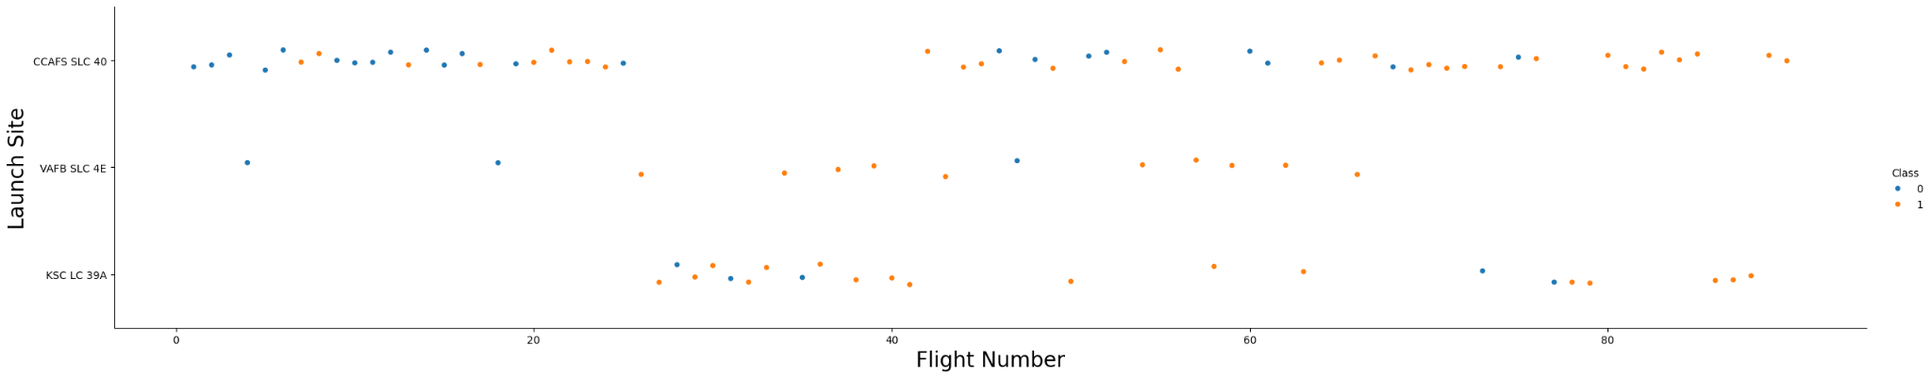
Flight Number vs. Launch Site
Initially, CCAFS SLC 40 was mostly the only Site used and which later became the most popular and trusted Site of the four sites
All Sites have been reasonably successful in their launches with an average success rate of about 80%

Slide 19
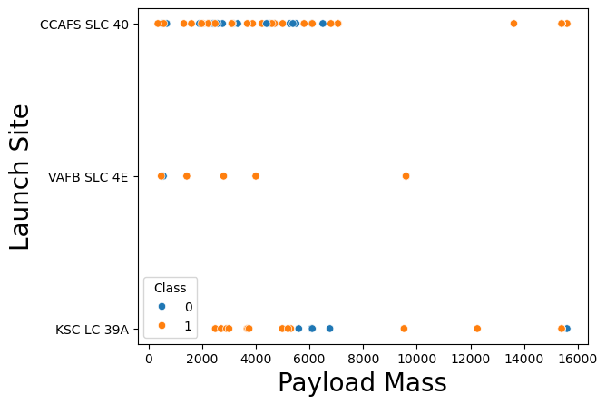
Payload vs. Launch Site
Most of the heavier payload launches have been successful (>8000Kg)
CCAFS SLC Site has the best record for range as well as success rate

Slide 20
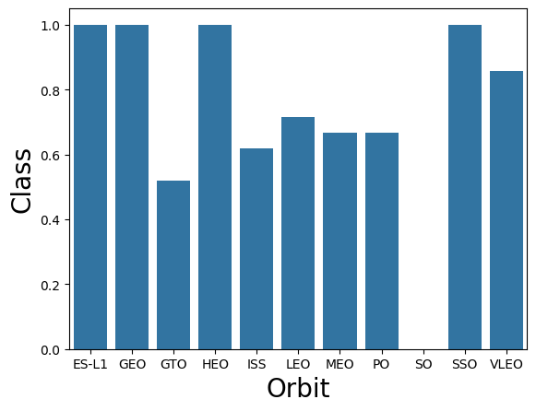
Success Rate vs. Orbit Type
GEO, ES-L1, HEO and SSO orbits have no records of failure

Slide 21
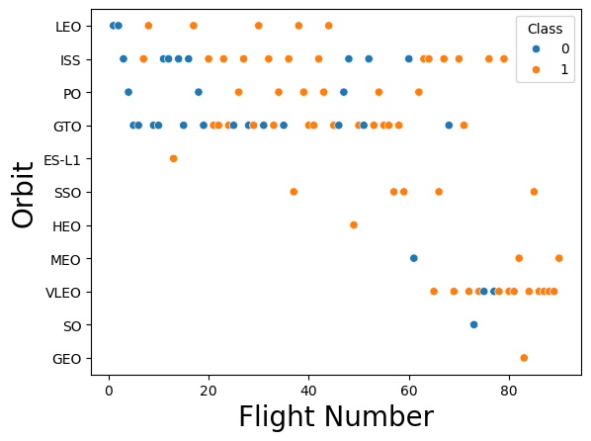
Flight Number vs. Orbit Type
ISS Orbit has been the most consistent destination for launches
VLEO most popular lately
GTO launches have been the most “dicey”

Slide 22
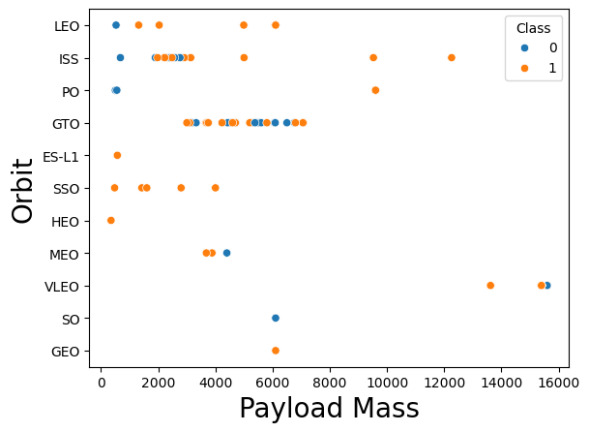
Payload vs. Orbit Type
The heavier the payload, the closer the orbit that would be a recommended destination
They are inversely related

Slide 23
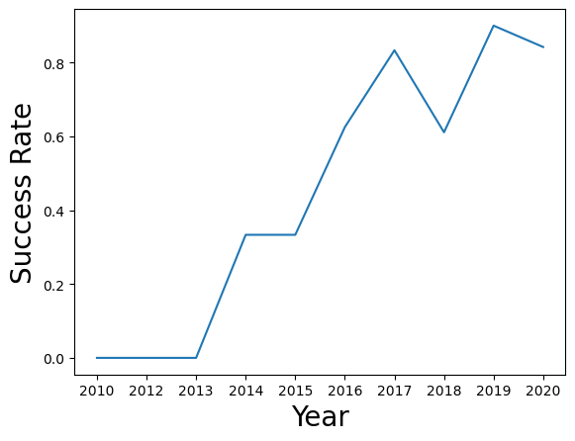
Launch Success Yearly Trend
SpaceX’s success rate has been rising since 2013
In 2019, it had the best success rate that it has ever enjoyed to date

Slide 24
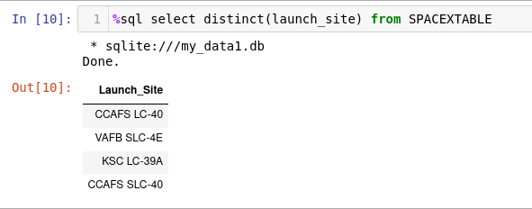
All Launch Site Names
Launch Sites featured in the dataset:
CCAFS LC-40
VAFB SLC-4E
KSC LC-39A
CCAFS SLC-40
These 4 have been all the distinct launch site names occurring in the dataset

Slide 25
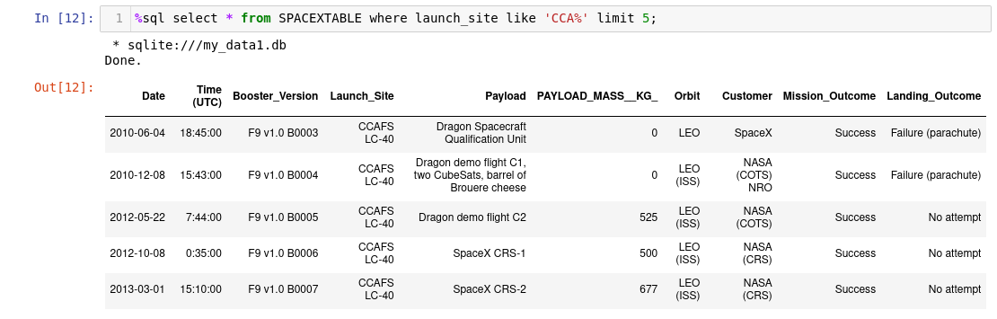
Launch Site Names Beginning with 'CCA'

Slide 26
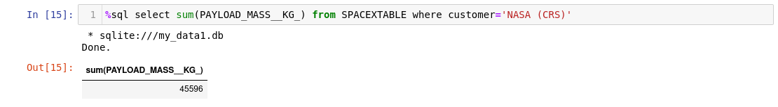
Total Payload Mass
Total payload mass carried by SpaceX rockets for NASA has been 45596 Kg!

Slide 27
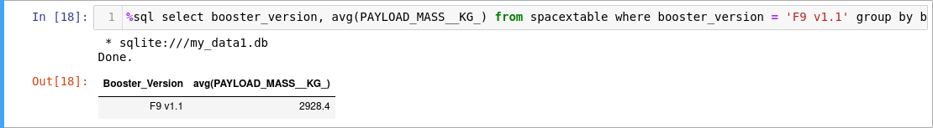
Average Payload Mass by F9 v1.1
The average payload mass carried by booster version F9 v1.1 is 2928.4 Kg

Slide 28
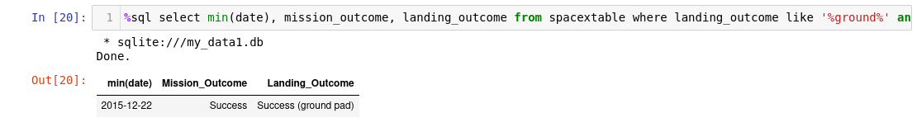
First Successful Ground Landing Date
SpaceX got its first successful launch in the year of 2015
It was most probably hemorrhaging money for about 5 years until then!

Slide 29
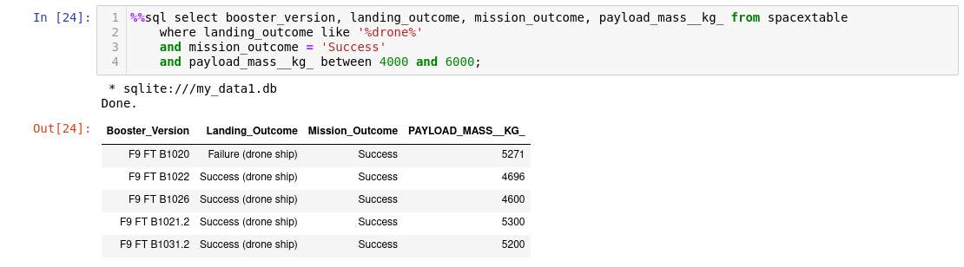
Successful Drone Ship Landing with Payload between 4000 and 6000
5 successful drone ship landings among 2 booster versions

Slide 30
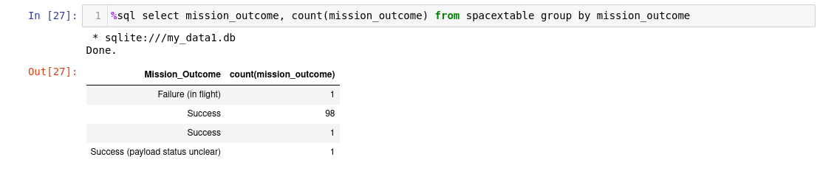
Total Number of Successful and Failure Mission Outcomes
Success rate has been an incredible 97.8%

Slide 31
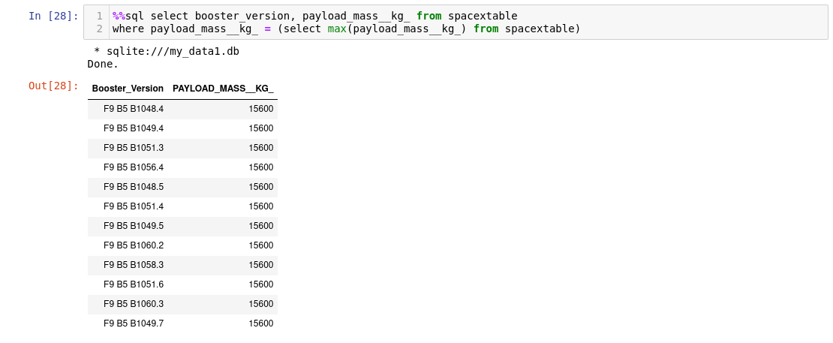
Boosters That Carried Maximum Payload
List the names of the booster which have carried the maximum payload mass
Present your query result with a short explanation here

Slide 32
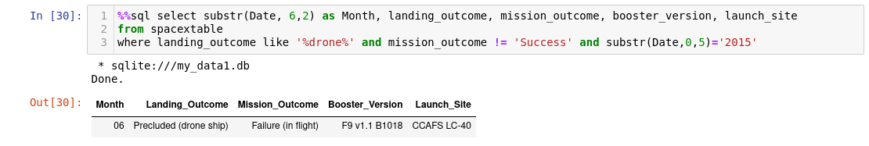
2015 Launch Records
There was only one failed launch in 2015

Slide 33
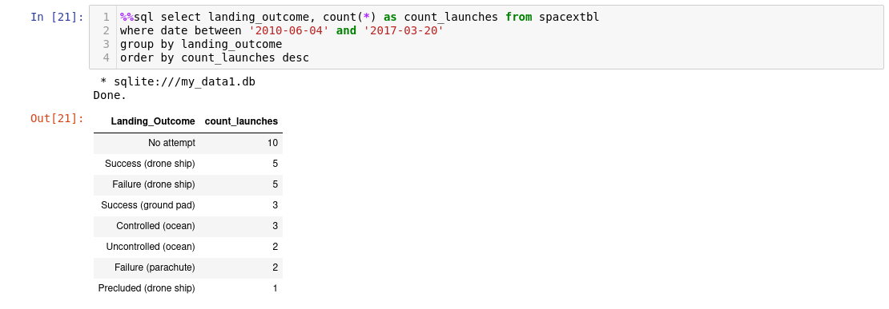
Rank Landing Outcomes Between 2010-06-04 and 2017-03-20

Slide 34

Section 3

Slide 35
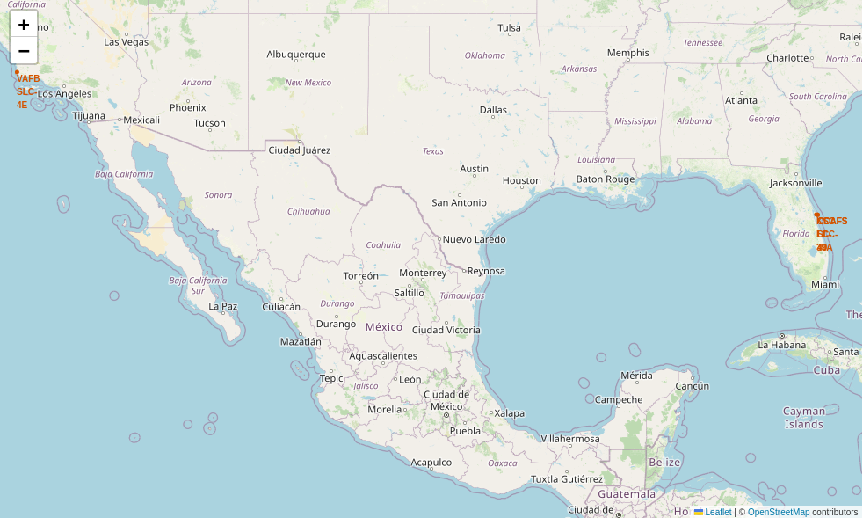
Geographic Visualization of Launch Sites
Replace <Folium map screenshot 1> title with an appropriate title
Explore the generated folium map and make a proper screenshot to include all launch sites’ location markers on a global map
Explain the important elements and findings on the screenshot

Slide 36
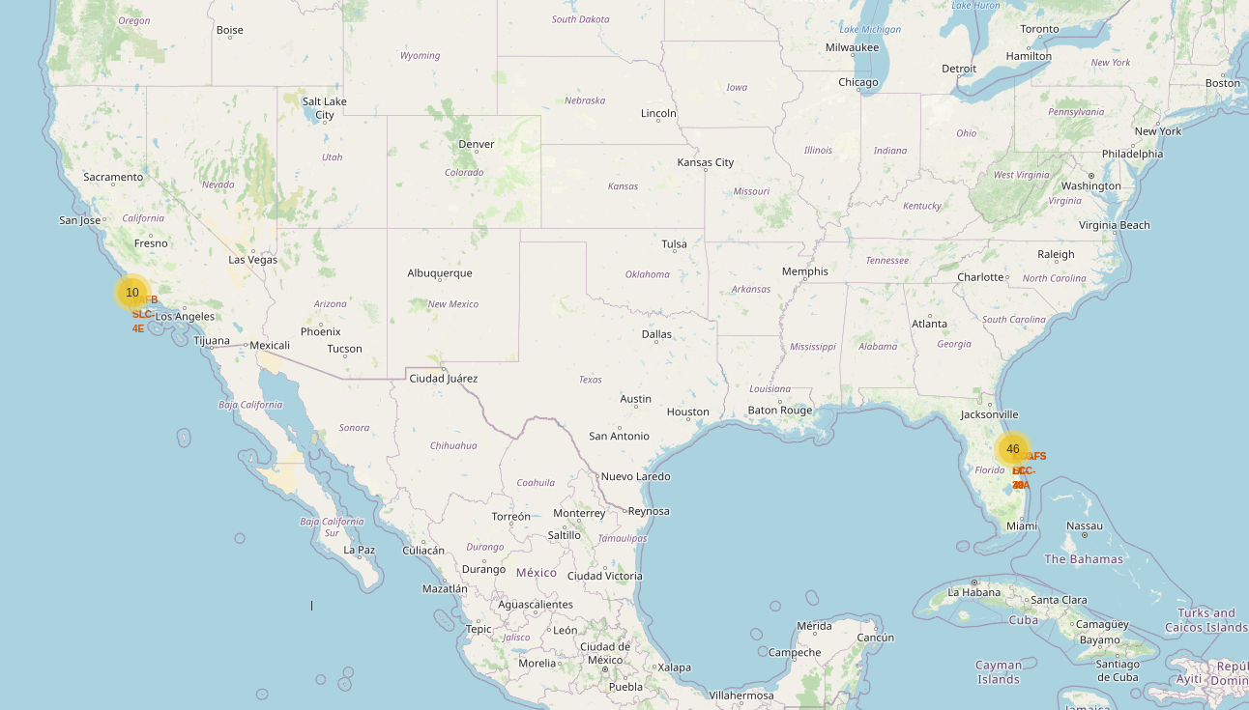
Success/ Failed Launches for each Site
Replace <Folium map screenshot 2> title with an appropriate title
Explore the folium map and make a proper screenshot to show the color-labeled launch outcomes on the map
Explain the important elements and findings on the screenshot

Slide 37
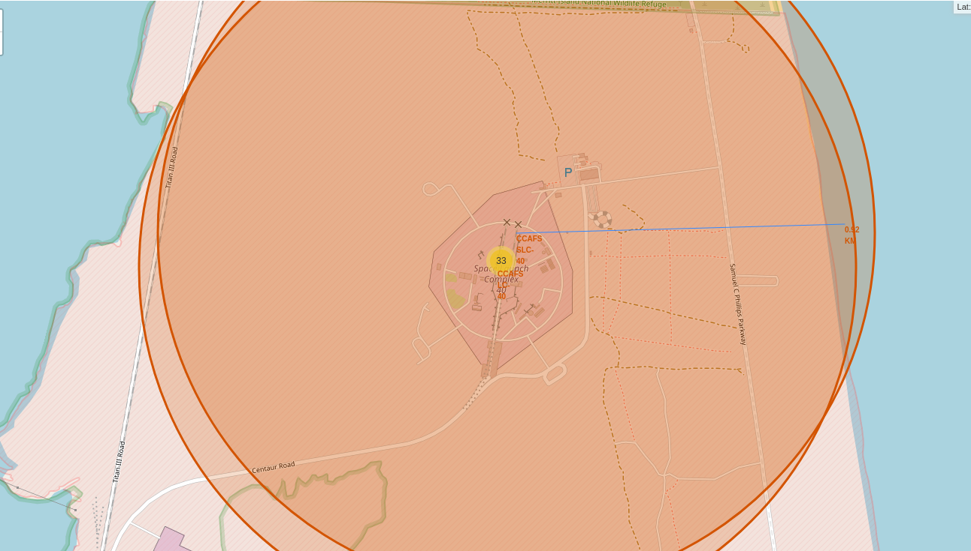
Distance from the Closest Coastline
Replace <Folium map screenshot 3> title with an appropriate title
Explore the generated folium map and show the screenshot of a selected launch site to its proximities such as railway, highway, coastline, with distance calculated and displayed
Explain the important elements and findings on the screenshot

Slide 38

Section 4

Slide 39
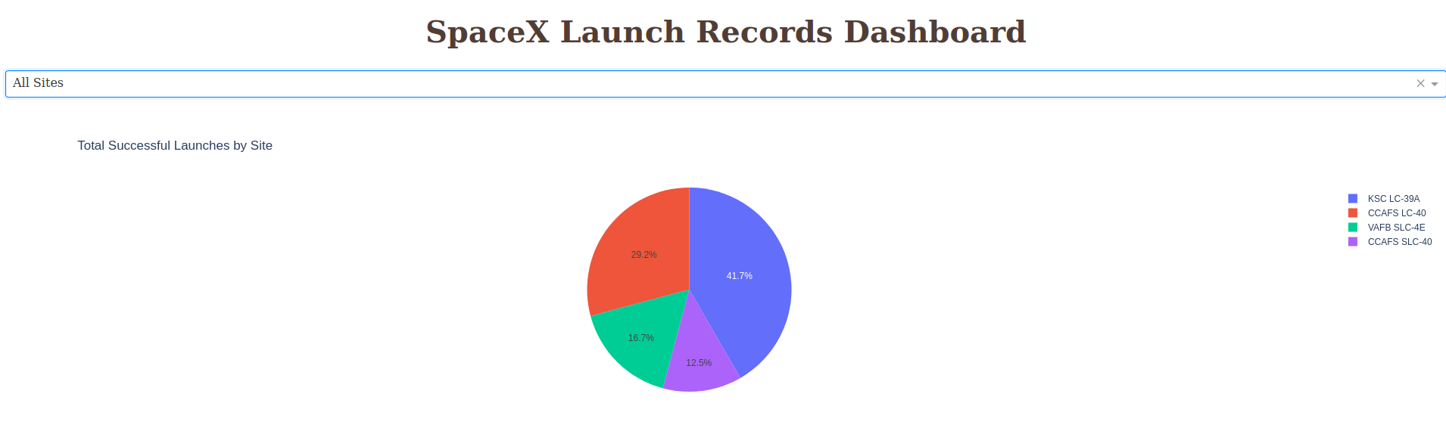
Success Rates per Site
KSC is the most reliable Launch Site for SpaceX

Slide 40
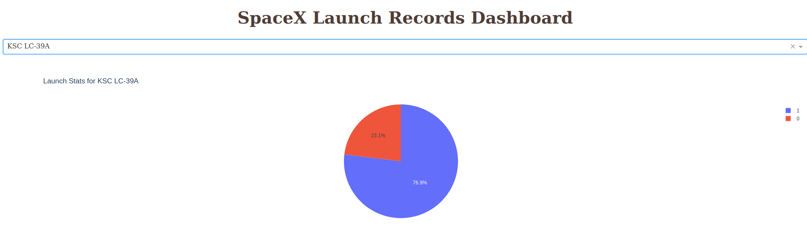
Launch Statistics for KSC LC-39A
KSC has a launch success rate of 77%

Slide 41
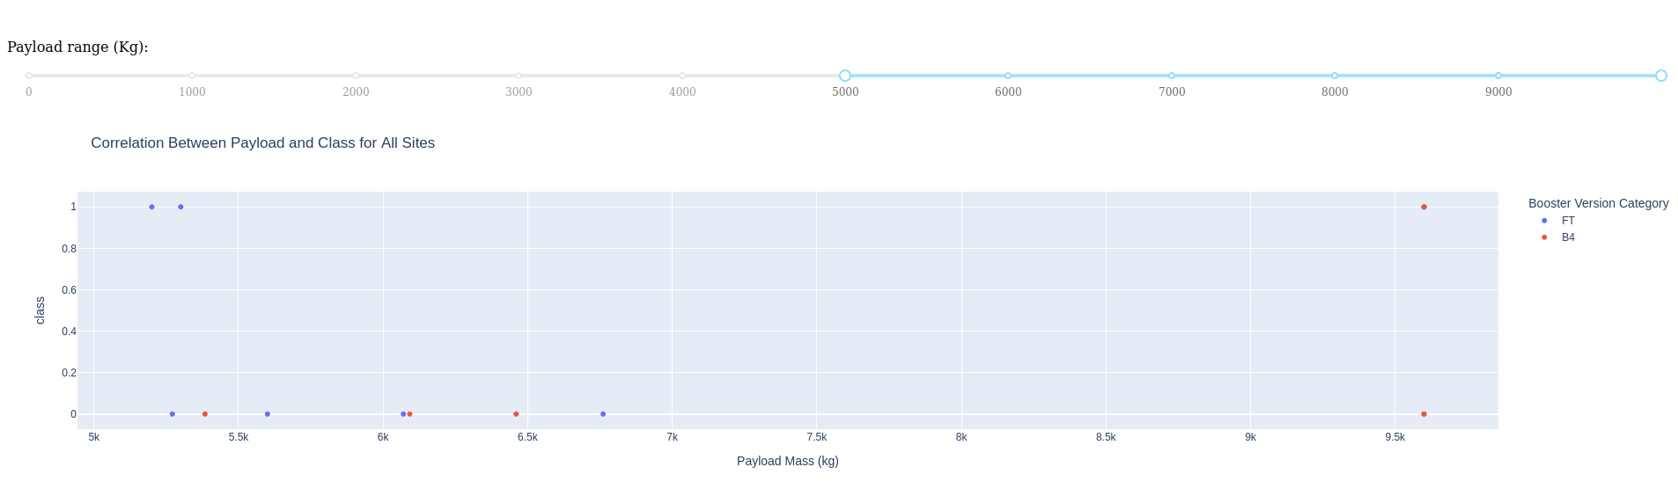
Outcomes for Payloads > 5000 Kg
Outcomes for Heavy category Payloads
Show screenshots of Payload vs. Launch Outcome scatter plot for all sites, with different payload selected in the range slider
Explain the important elements and findings on the screenshot, such as which payload range or booster version have the largest success rate, etc.

Slide 42
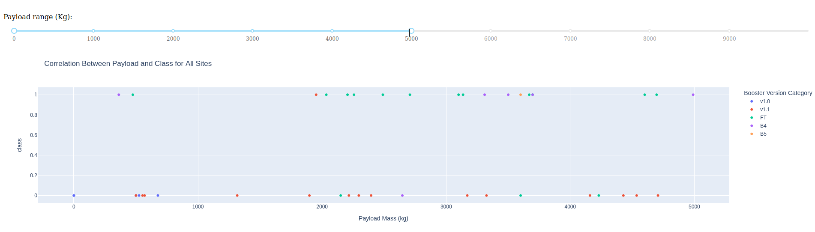
Outcomes for Payloads < 5000 Kg
Outcomes for Light category Payloads

Slide 43

Section 5

Slide 44
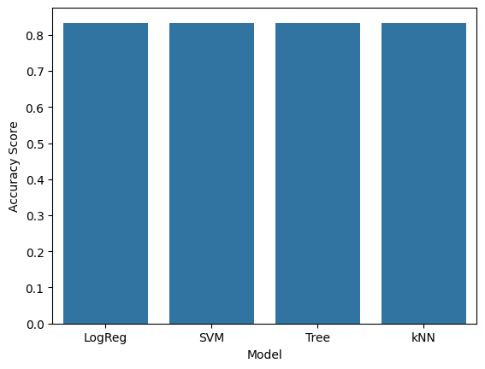
Classification Accuracy
All models scored exactly the same accuracy value of 83.34%
Decision Trees showed quickest training time of the lot, thus chosen until re-training

Slide 45

Confusion Matrix
The Decision Tree model was able to correctly guess 15 out of 18 test scenarios
Of the 3 failed, all of them were wrongly predicted to have successfully landed, which accounts to a false positive error
False Positives must be avoided more vigorously than False Negatives as false optimism shall cost SpaceY a lot of money

Slide 46
Conclusions

Slide 47
Appendix
Include any relevant assets like Python code snippets, SQL queries, charts, Notebook outputs, or data sets that you may have created during this project

Slide 48


